Slide 1

Receipt Keeper
Receipt Management Application
Changho Choi
Hassan Nahhal
Nicholas Collins
SungJoe Kim
Mobile Solutions Development

Slide 2






Team members
Changho Choi
Mobile UI/ Web Sync.
Hassan Nahhal
Mobile UI/ Back-End
Nicholas Collins
OCR/ Mobile Front-End
SungJoe Kim
Web UI/ Front/ Back-End
Notes:
Move this slide when Q&A sections

Slide 3

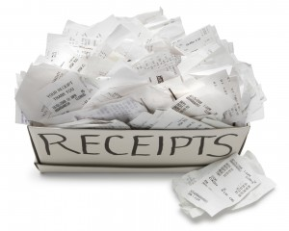
Introduction
be familiar with spending
avoid impulse buying
manage your money
save you time & effort
here’s the way …
Notes:
Sequence
Introduction / Agenda : Hassan
Problem/Solution : Nick
Tech. : Chang
Mobile Features : Hassan
Web Features : Joe
Plan/Conclusion :Nick
Introduction : Hassan will prepare expression and proper images

Slide 4

Agenda
problem
solution
technologies
methodologies
features (mobile/ web)
future plans
conclusion
Notes:
What’s it (This slide is not necessary)

Slide 5




Problem
forget stuff bought
tracking all of this is a handful
strict budget
alternative is not ultimate
a long process to start using it
offer limited functions
focused on private, personal use
Notes:
Here’s Nick

Slide 6






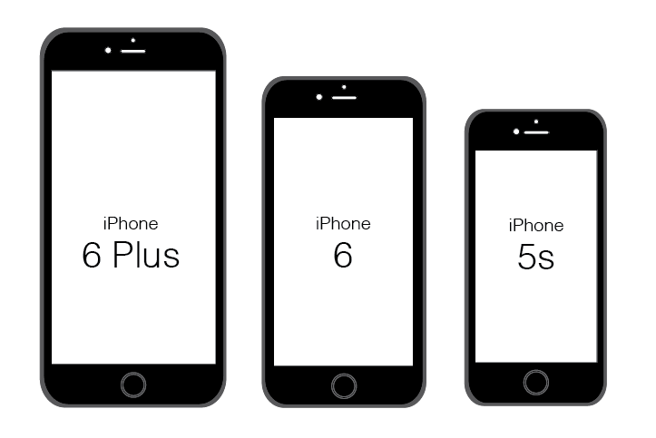

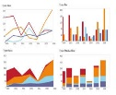
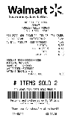
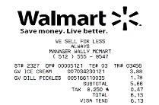
Our Solution
quick and easy access to start
no extra devices required
scan receipt & store it online
filter, search for receipts, export as files
generate charts, reports feedback
support working in groups

Slide 7







Work Process
scan
receipt
output
data
save in
database
track
expenses
view
anywhere
Notes:
From here, Chang

Slide 8





















Technologies
BAAS
DAAS
web
PAAS / SVC
mobile

Slide 9




Methodologies
development methodology
Agile Unified Process (2 week iterations)
source control & change management
3 GitHub repositories
master and branch (dev_prod)
wiki to keep track of outcome
issues tracking to assign fixes or tasks
communication
Slack and regular meetings
Notes:
Use Icon to explain above text descriptions
Modify and improve from Chang and add proper images

Slide 10

Domain Model
User
Receipt
File
*
*
1
1
0..
*
<<belongs to>>
0..
<<belongs to>>
Store
*
0..
Group
Tag
*
0..
*
0..
<<belongs to>>
Category
Notification

Slide 11


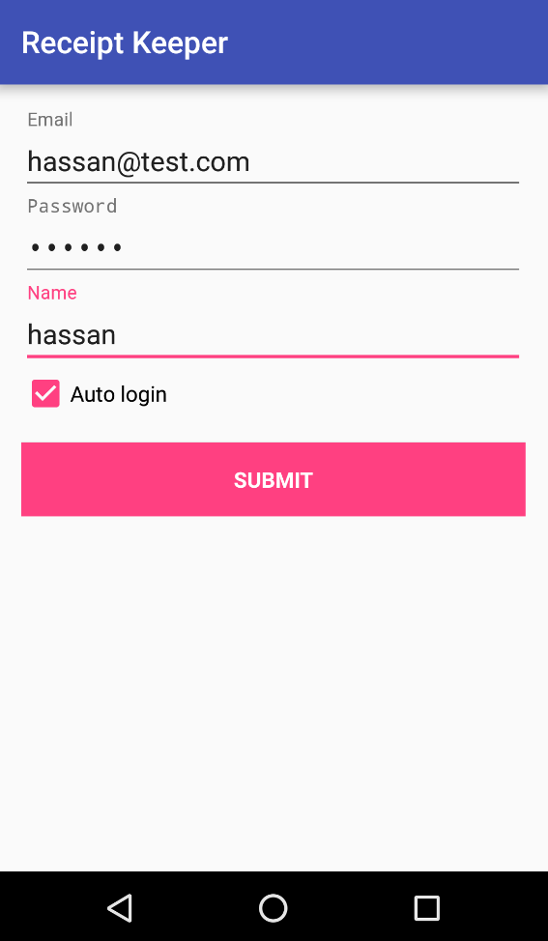
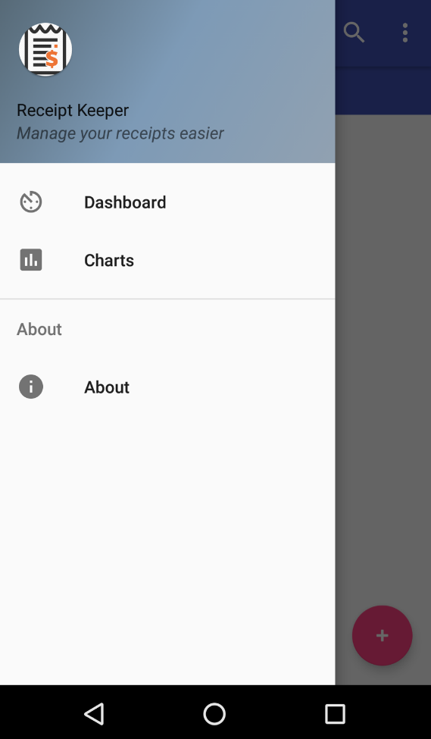
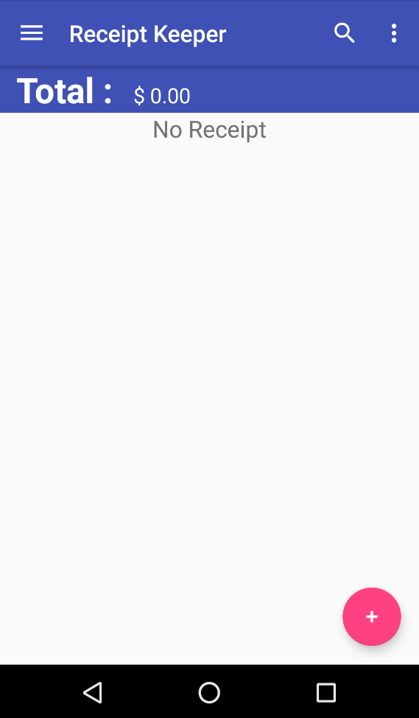
Features (mobile app)
sign up/in
main page
sliding view
Notes:
From here : Hassan
Screenshots for major actions and short words

Slide 12
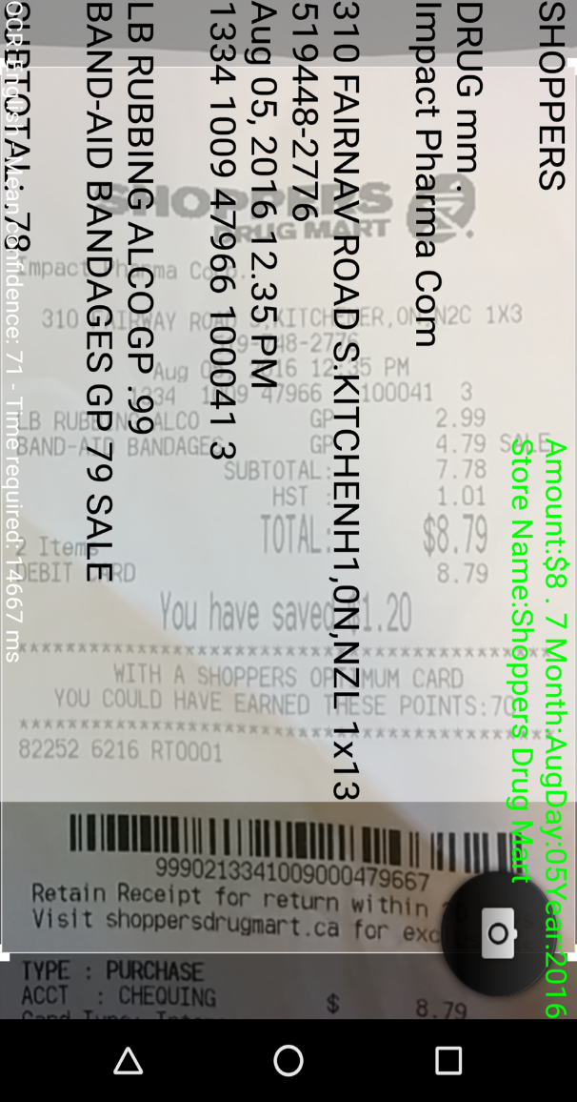
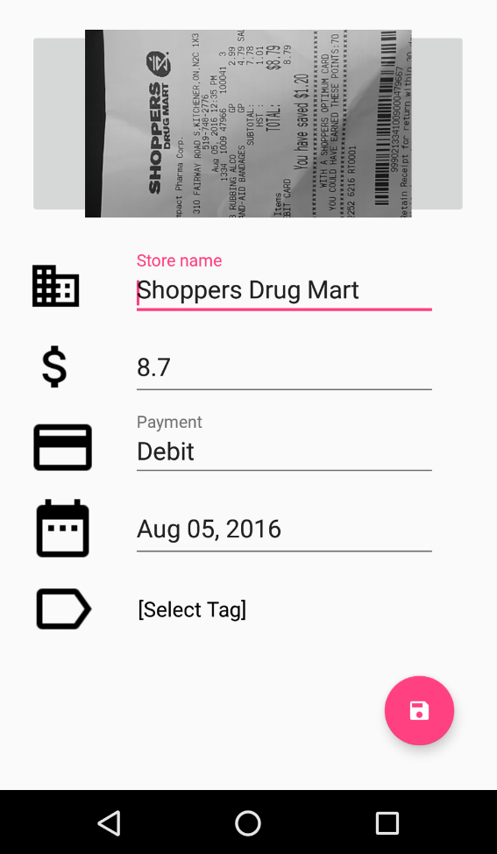
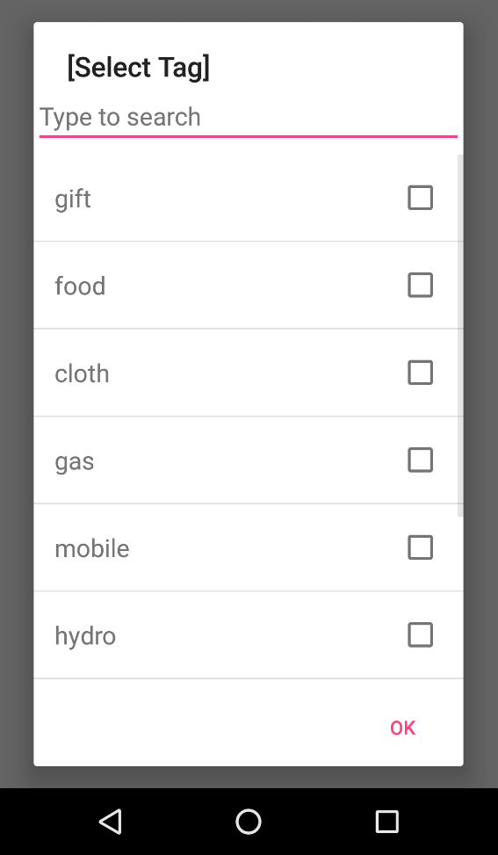
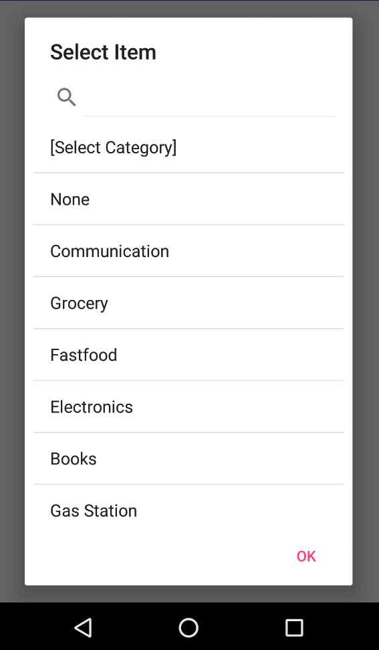
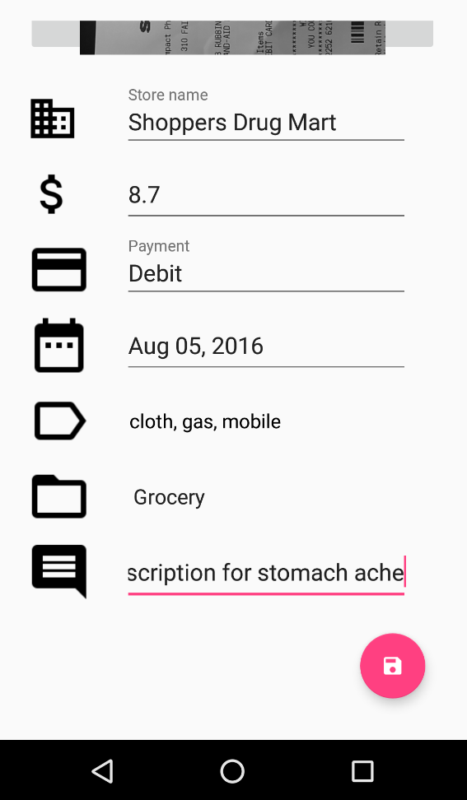
Features (cont.)
add tag
select category
save
receipt
data
collected through text recognition
scanning receipt

Slide 13
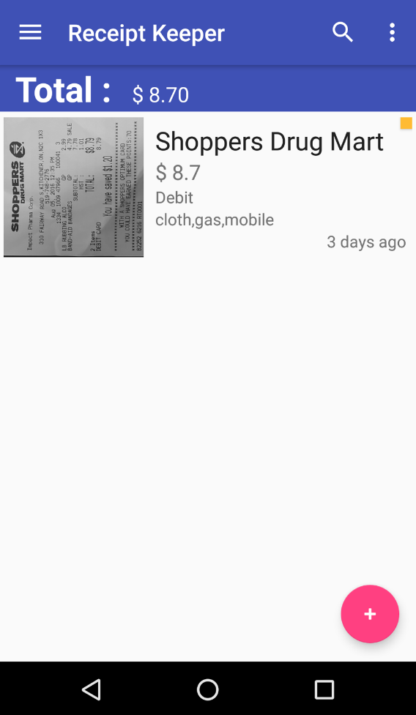
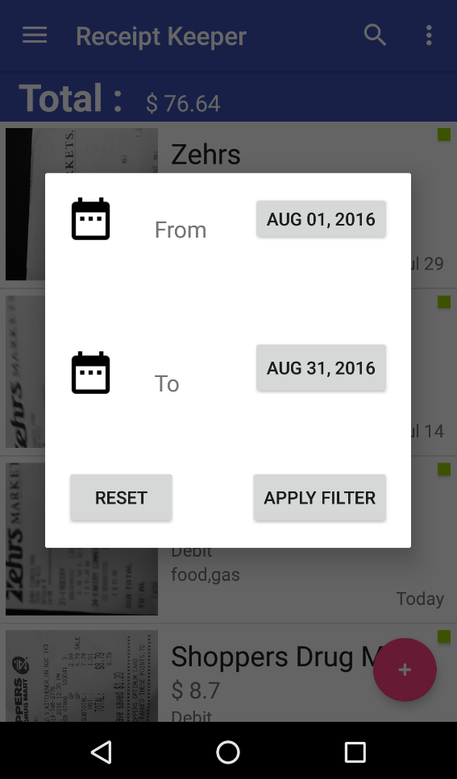
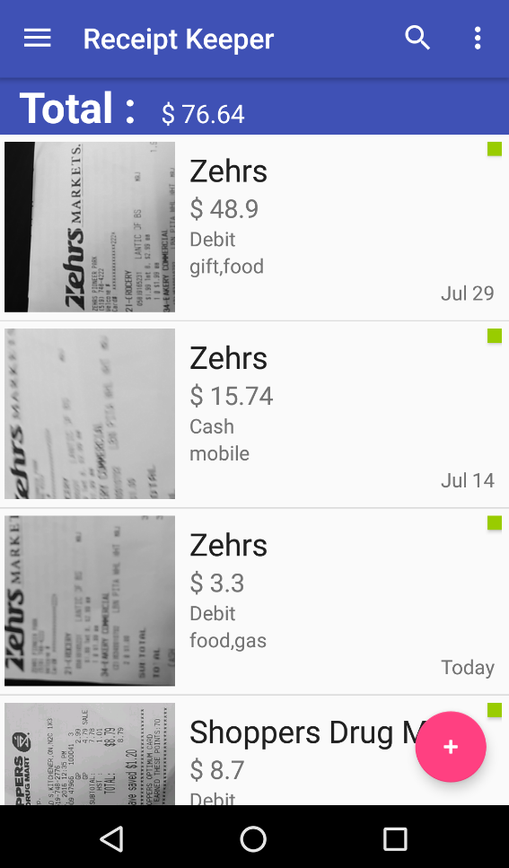
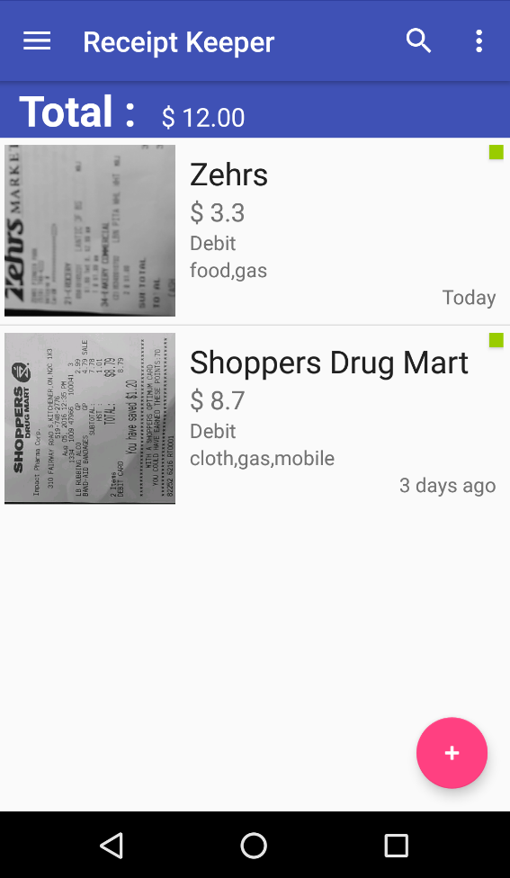
Features (cont.)
apply filter…
web sync.
filter results
receipts
list

Slide 14
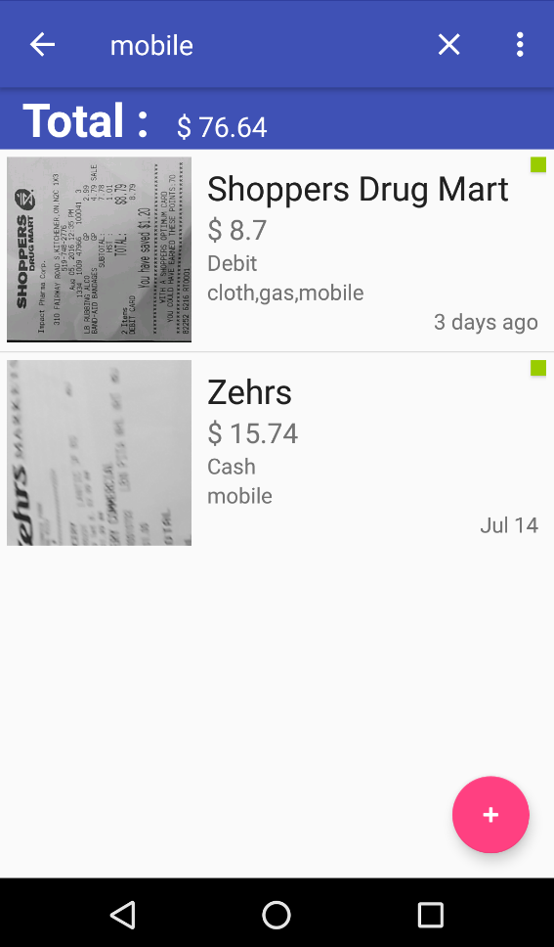
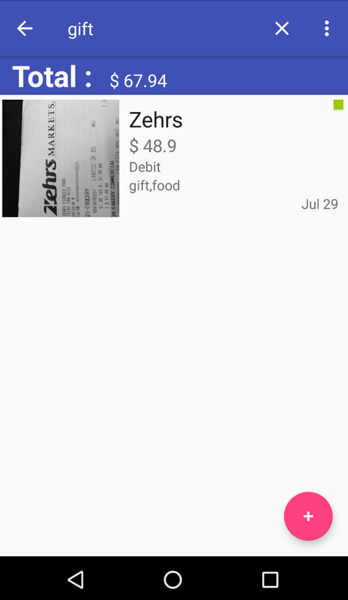
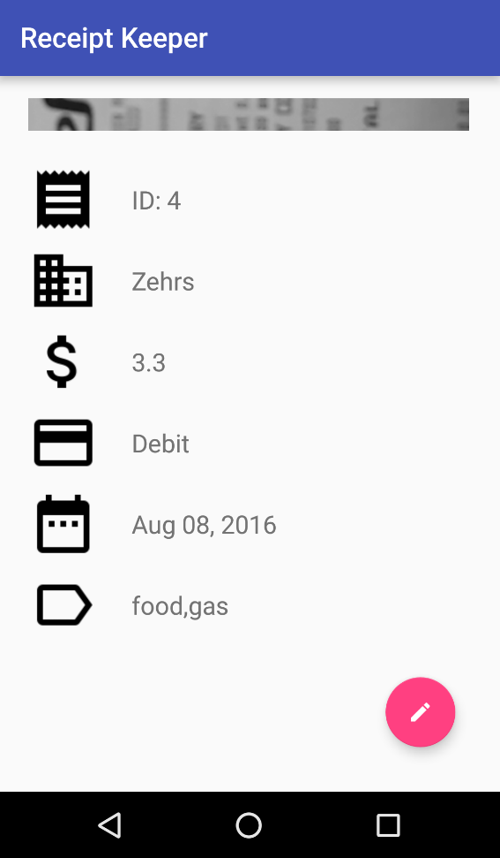
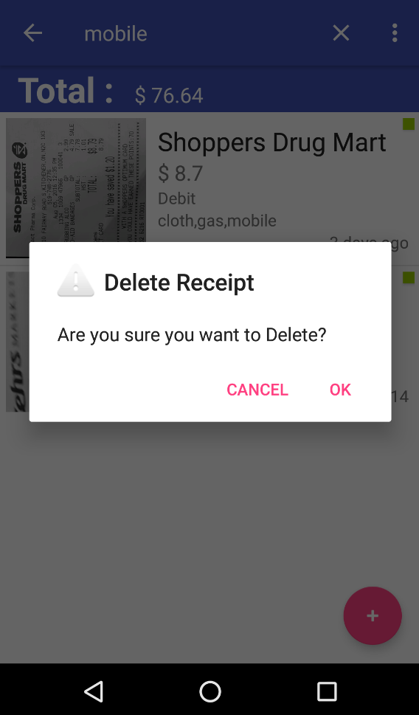
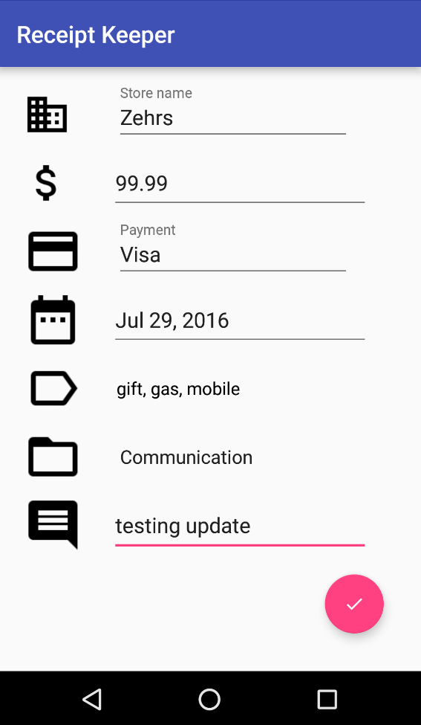
Features (cont.)
long touch
short touch
view details
delete
update

Slide 15


Features (web app)

Slide 16
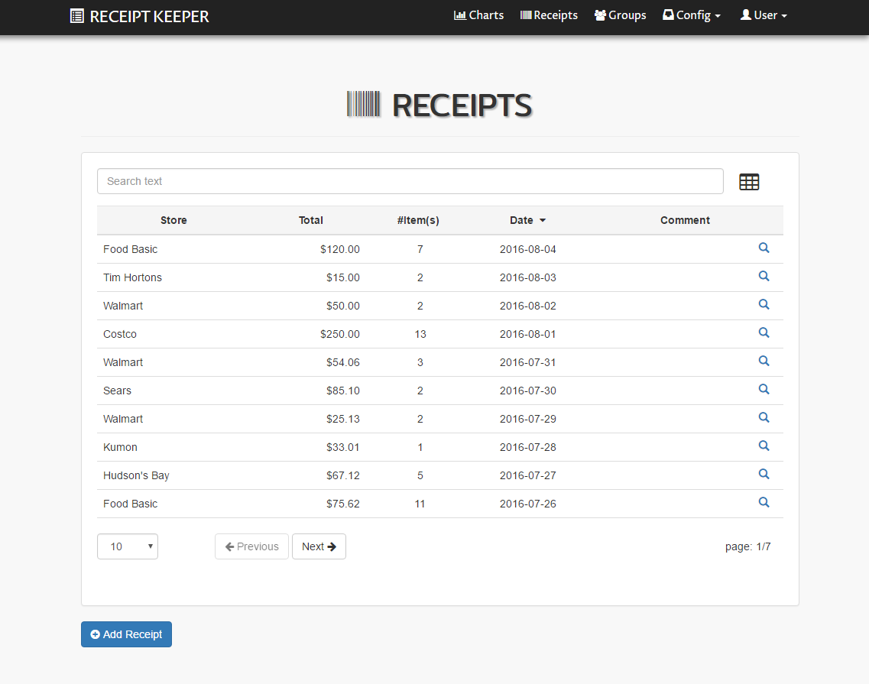
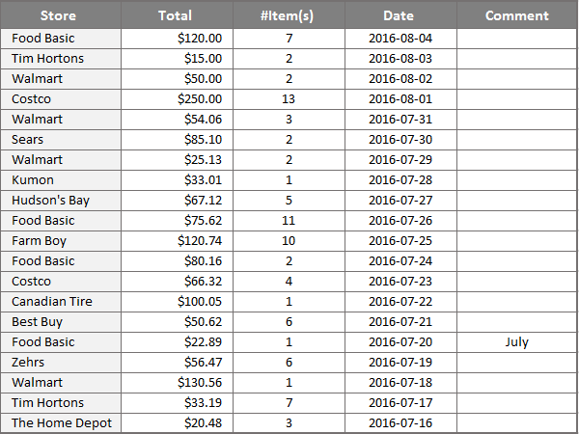
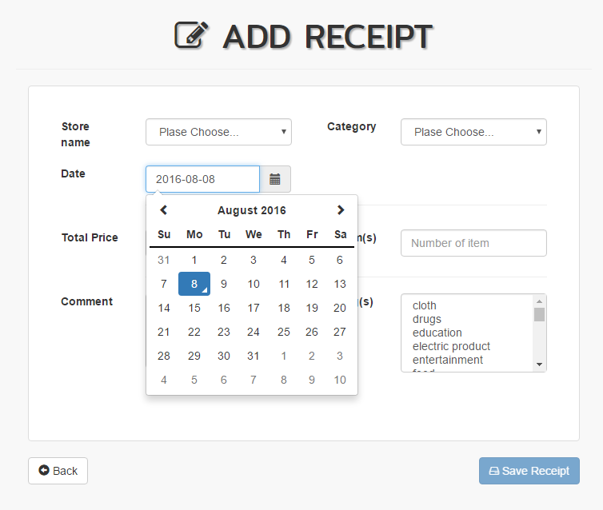
Features (cont.)
search/ sort/ pagination/ excel export

Slide 17
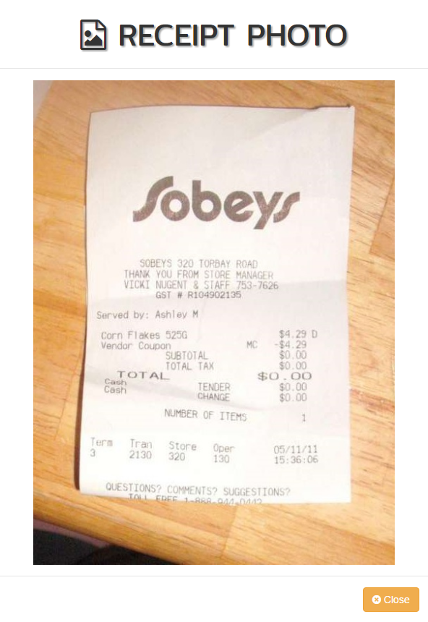
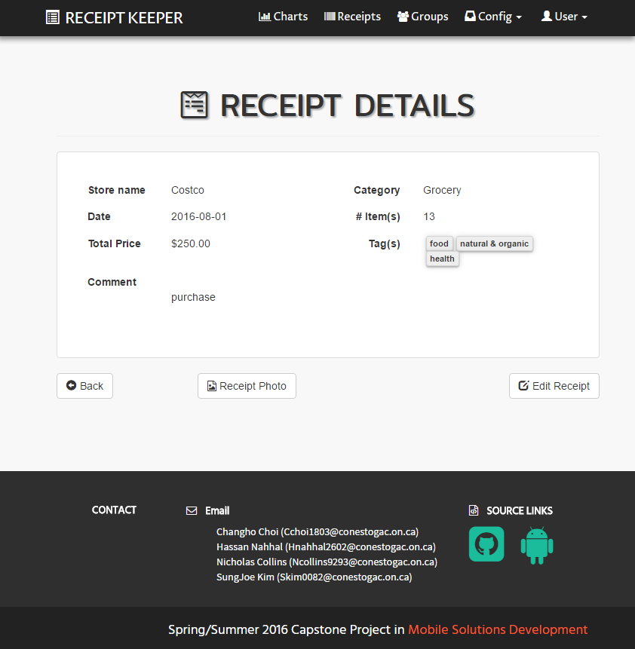
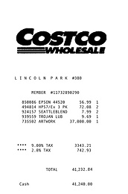
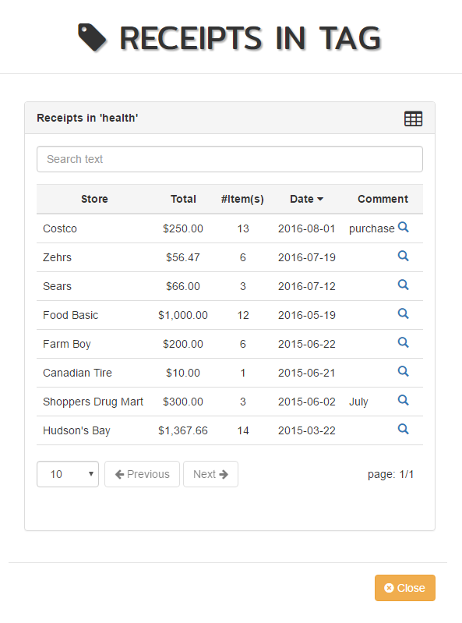
Features (cont.)
receipt photo/ extract receipts from tag

Slide 18
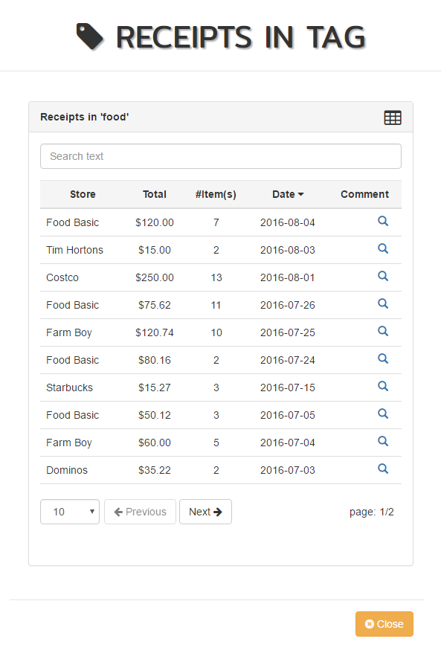
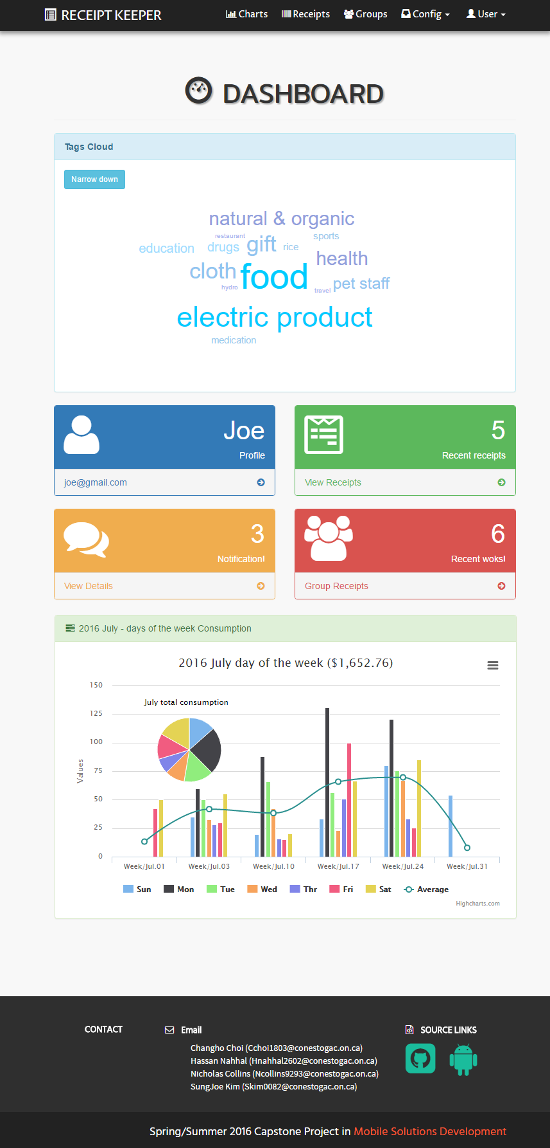
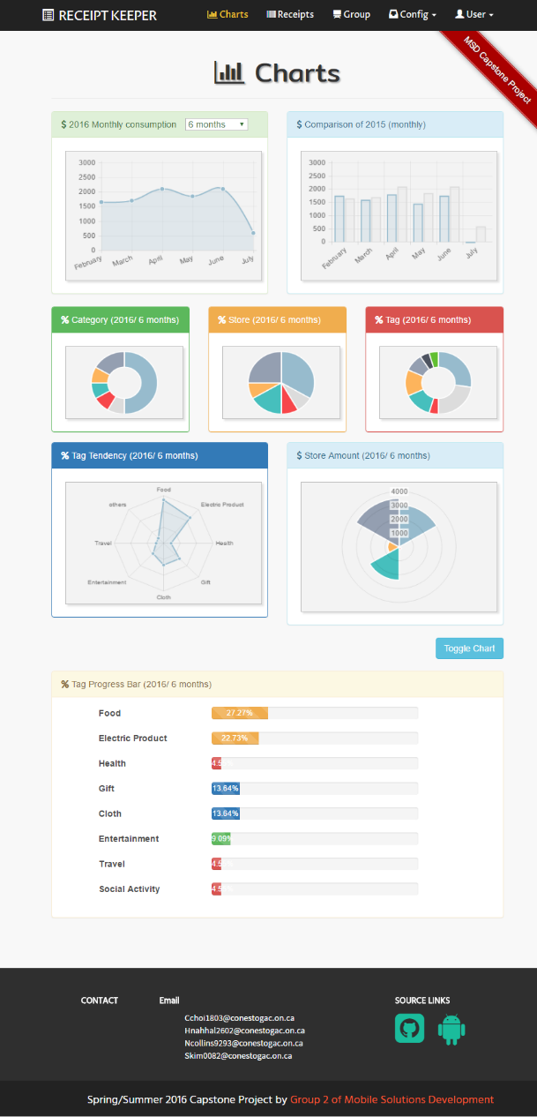
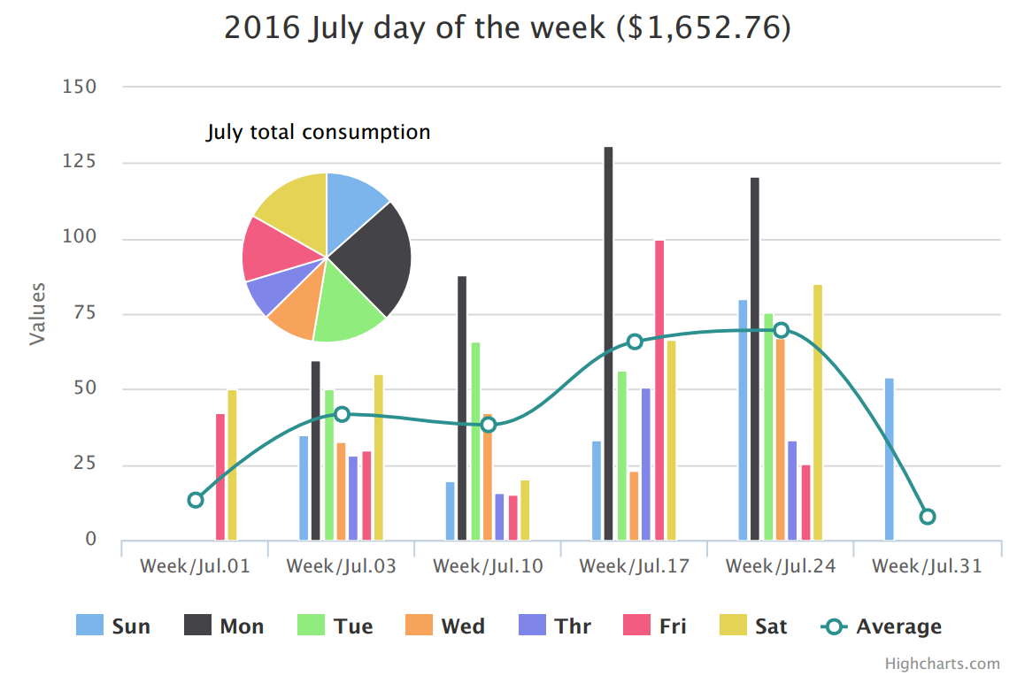
Features (cont.)

Slide 19
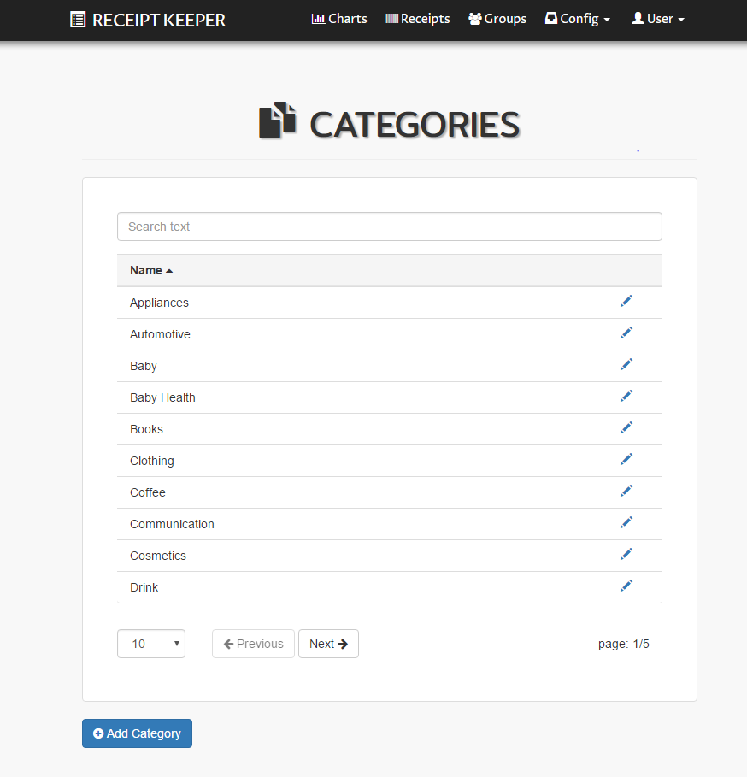
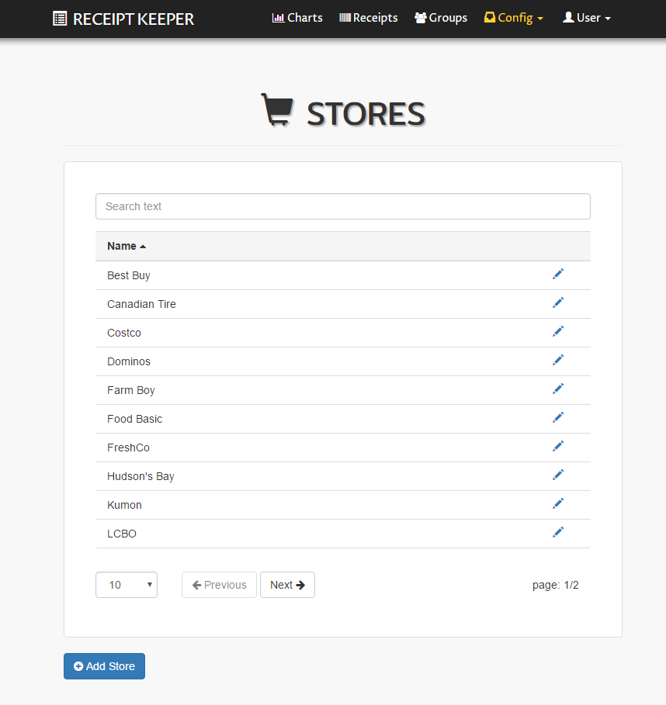
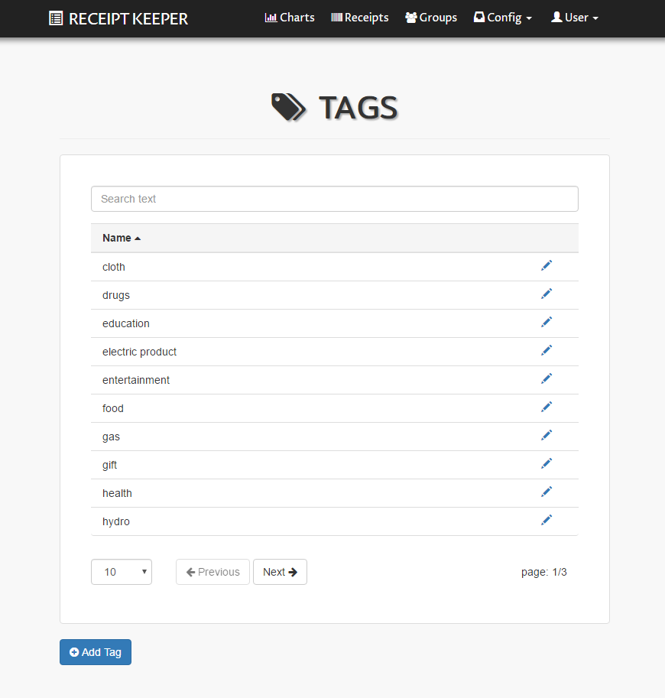



Features (cont.)
user organize data structure
category/ store/ tag
view reports based
on them

Slide 20
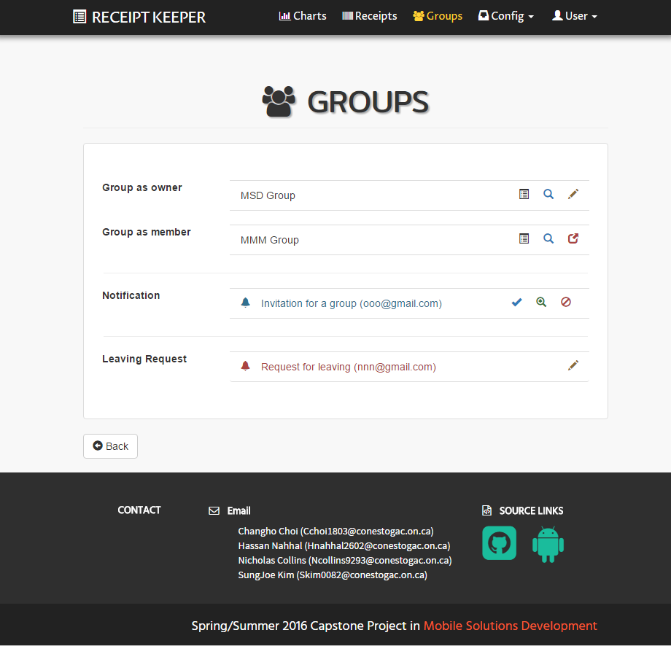
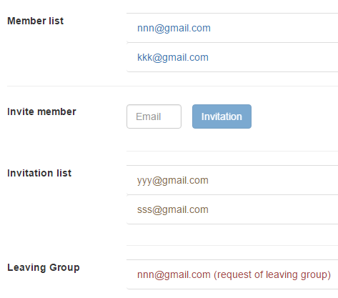

Features (cont.)
create group
works in group
invite member
store & share

Slide 21


Future Plans
save daily paperless receipts
import/ export in various formats
switch between account type
combine multiple images
OpenCV to improve accuracy
track each member in group
retrieve from specific item
Notes:
Here, again Nick

Slide 22


Conclusion
scan receipts with mobile devices
save data local or online
track spending
view and export reports as files
provide various visual information
access anywhere/ anytime
support working in group

Slide 23
Receipt Keeper
Receipt Management Application
Changho Choi
Hassan Nahhal
Nicholas Collins
SungJoe Kim
Mobile Solutions Development

